Slide 1
FLOW AND ERROR CONTROL

Slide 2
The most important responsibilities of the data link layer are flow control and error control. Collectively, these functions are known as data link control.

Slide 3

Note
Flow control refers to a set of procedures used to restrict the amount of data
that the sender can send before
waiting for acknowledgment.

Slide 4
Note
Error control in the data link layer is based on automatic repeat request, which is the retransmission of data.

Slide 5
PROTOCOLS
Now let us see how the data link layer can combine framing, flow control, and error control to achieve the delivery of data from one node to another. The protocols are normally implemented in software by using one of the common programming languages.

Slide 6
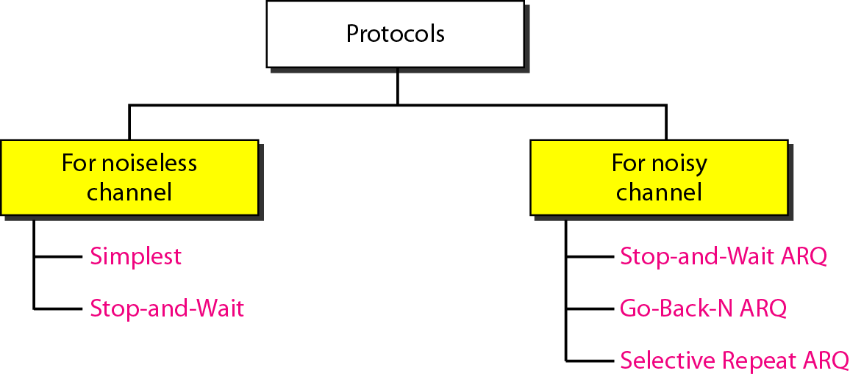
Figure Taxonomy of protocols

Slide 7
NOISELESS CHANNELS
Let us first assume we have an ideal channel in which no frames are lost, duplicated, or corrupted. We introduce two protocols for this type of channel.

Slide 8
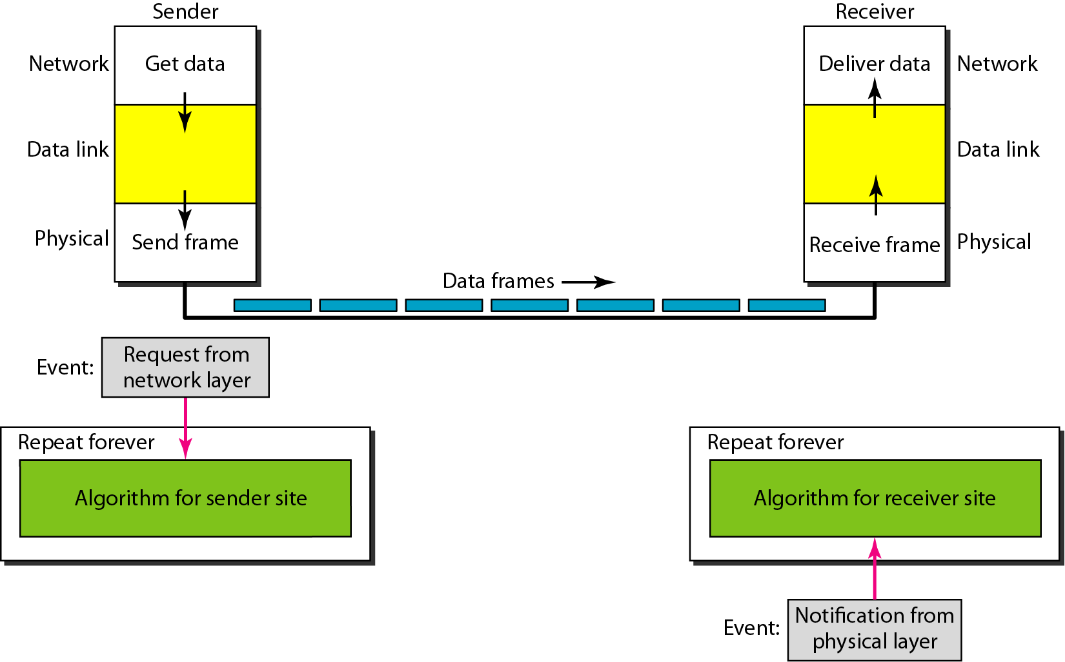
Figure The design of the simplest protocol with no flow or error control

Slide 9
Example
Figure 11.7 shows an example of communication using this protocol. It is very simple. The sender sends a sequence of frames without even thinking about the receiver. To send three frames, three events occur at the sender site and three events at the receiver site. Note that the data frames are shown by tilted boxes; the height of the box defines the transmission time difference between the first bit and the last bit in the frame.

Slide 10
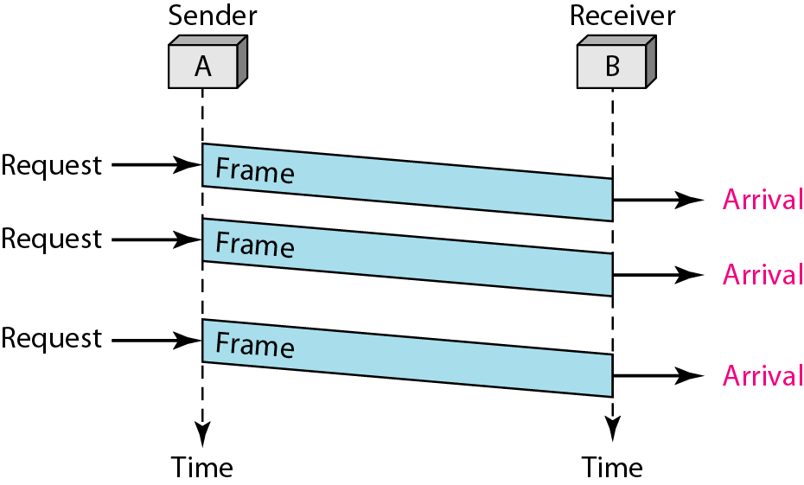
Figure Flow diagram for Example

Slide 11
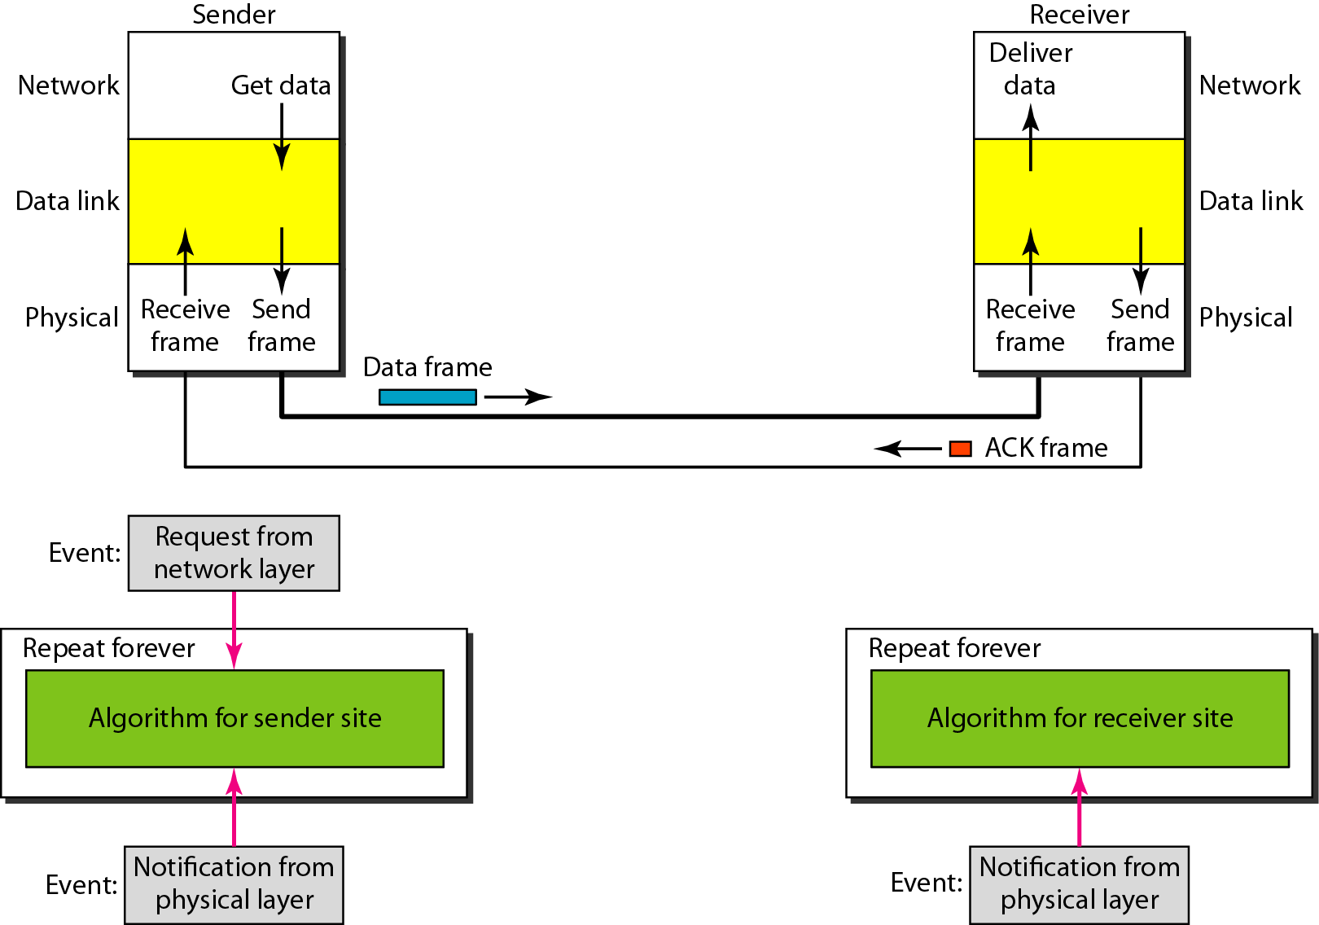
Figure Design of Stop-and-Wait Protocol

Slide 12
Example
Figure shows an example of communication using this protocol. It is still very simple. The sender sends one frame and waits for feedback from the receiver. When the ACK arrives, the sender sends the next frame.

Slide 13
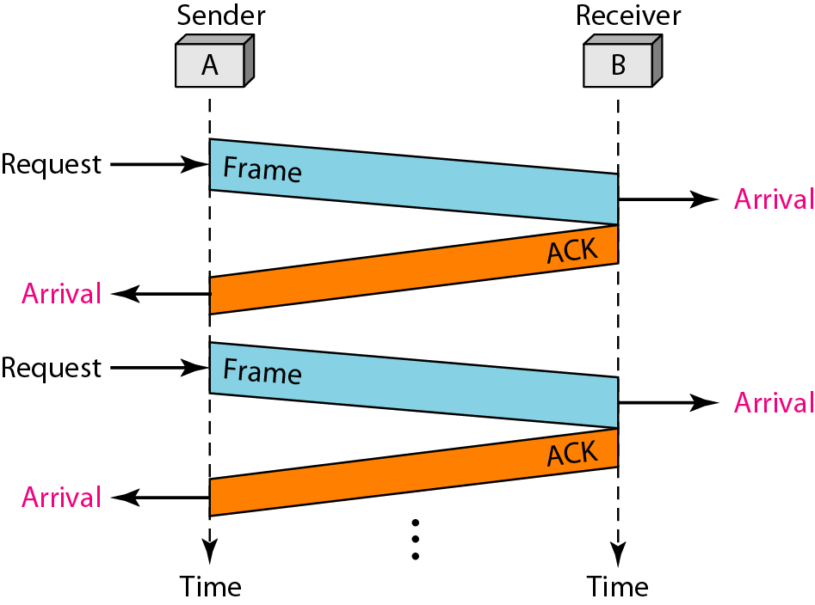
Figure Flow diagram for Example

Slide 14
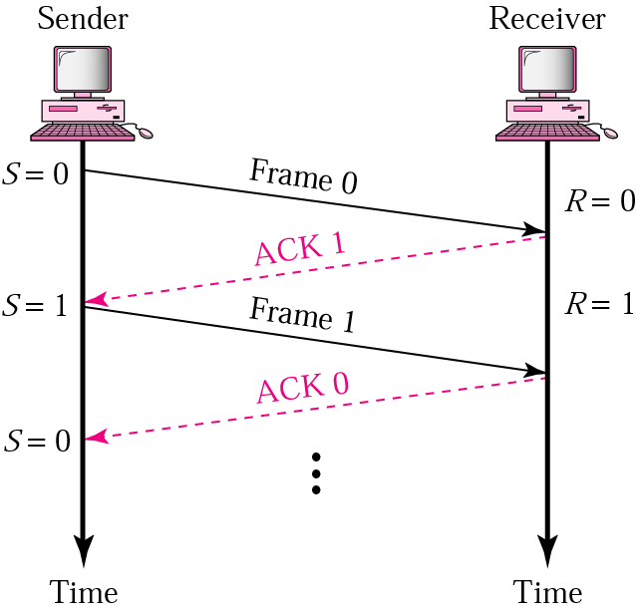
Stop-and-Wait
Sender keeps a copy of the last frame until it receives an acknowledgement.
For identification, both data frames and acknowledgements (ACK) frames are numbered alternatively 0 and 1.
Sender has a control variable (S) that holds the number of the recently sent frame. (0 or 1)
Receiver has a control variable ® that holds the number of the next frame expected (0 or 1).
Sender starts a timer when it sends a frame. If an ACK is not received within a allocated time period, the sender assumes that the frame was lost or damaged and resends it
Receiver send only positive ACK if the frame is intact.
ACK number always defines the number of the next expected frame

Slide 15
Error control in the data link layer is bae on ARQ , which means retransmission of data in three case:
Lost frame
Lost acknowledge
Delayed acknowledge

Slide 16
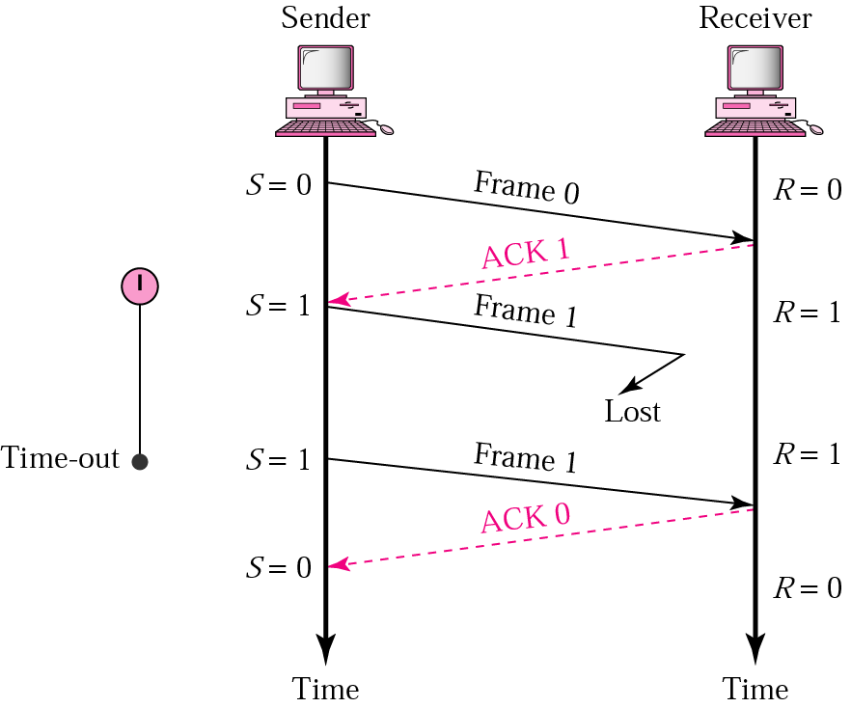
Stop-and-Wait ARQ, lost frame
When a receiver receives a damaged frame, it discards it and keeps its value of R.
After the timer at the sender expires, another copy of frame 1 is sent.

Slide 17
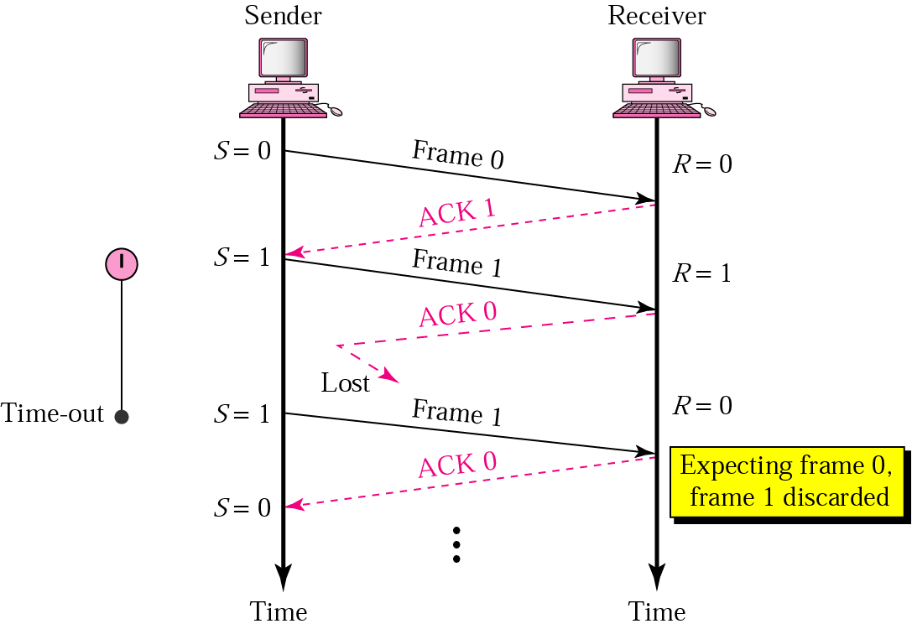
Stop-and-Wait, lost ACK frame
If the sender receives a damaged ACK, it discards it.
When the timer of the sender expires, the sender retransmits frame 1.
Receiver has already received frame 1 and expecting to receive frame 0 (R=0). Therefore it discards the second copy of frame 1.

Slide 18
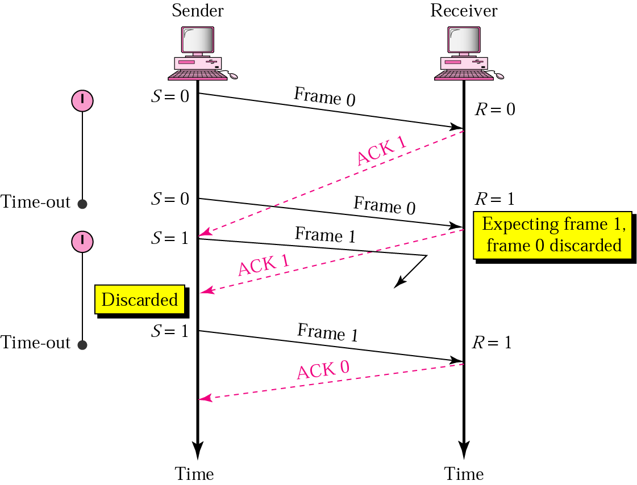
Stop-and-Wait, delayed ACK frame
The ACK can be delayed at the receiver or due to some problem
It is received after the timer for frame 0 has expired.
Sender retransmitted a copy of frame 0. However, R =1 means receiver expects to see frame 1. Receiver discards the duplicate frame 0.
Sender receives 2 ACKs, it discards the second ACK.

Slide 19
Stop-and-Wait, delayed ACK frame
The ACK can be delayed at the receiver or due to some problem
It is received after the timer for frame 0 has expired.
Sender retransmitted a copy of frame 0. However, R =1 means receiver expects to see frame 1. Receiver discards the duplicate frame 0.
Sender receives 2 ACKs, it discards the second ACK.

Slide 20
Disadvantage of Stop-and-Wait
In stop-and-wait, at any point in time, there is only one frame that is sent and waiting to be acknowledged.
This is not a good use of transmission medium.
To improve efficiency, multiple frames should be in transition while waiting for ACK.
Two protocol use the above concept,
Go-Back-N ARQ
Selective Repeat ARQ

Slide 21
Problems
If the bandwidth of the line is 1.5 Mbps, RTT is 45 msec and packet size is 1 KB, then find the link utilization in stop and wait.
A channel has a bit rate of 4 Kbps and one way propagation delay of 20 msec. The channel uses stop and wait protocol. The transmission time of the acknowledgement frame is negligible. To get a channel efficiency of at least 50%, the minimum frame size should be:

Slide 22
3. Consider a MAN with average source and destination 20 Km apart and one way delay of 100 μsec. At what data rate does the round trip delay equals the transmission delay for a 1 KB packet?
4. If the packet size is 1 KB and propagation time is 15 msec, the channel capacity is 10⁹ b/sec, then find the transmission time and utilization of sender in stop and wait protocol.
5. A system uses the Stop-and-Wait Protocol. If each packet carries 1000 bits of data, how long does it take to send 1 million bits of data if the distance between the sender and receiver is 5000 Km and the propagation speed is 2 x 108 m/s? Ignore transmission, waiting, and processing delays. We assume no data or control frame is lost or damaged.

Slide 23
Go-Back-N ARQ
We can send up to W frames before worrying about ACKs.
We keep a copy of these frames until the ACKs arrive.
This procedure requires additional features to be added to Stop-and-Wait ARQ.

Slide 24
Sequence Numbers
Frames from a sender are numbered sequentially.
We need to set a limit since we need to include the sequence number of each frame in the header.
If the header of the frame allows m bits for sequence number, the sequence numbers range from 0 to 2 ^{m} – 1. for m = 3, sequence numbers are: 1, 2, 3, 4, 5, 6, 7.
We can repeat the sequence number.
Sequence numbers are:
0, 1, 2, 3, 4, 5, 6, 7, 0, 1, 2, 3, 4, 5, 6, 7, 0, 1, …

Slide 25
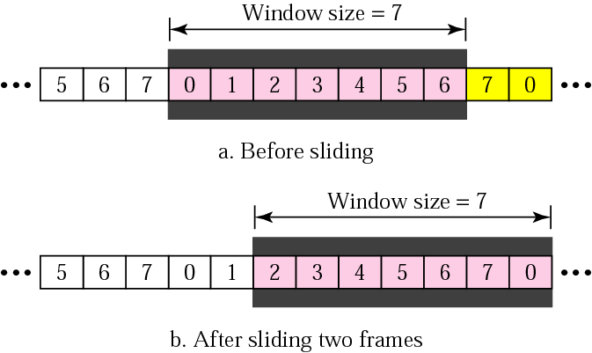
Sender Sliding Window
At the sending site, to hold the outstanding frames until they are acknowledged, we use the concept of a window.
The size of the window is at most 2^{m} -1 where m is the number of bits for the sequence number.
Size of the window can be variable, e.g. TCP.
The window slides to include new unsent frames when the correct ACKs are received

Slide 26
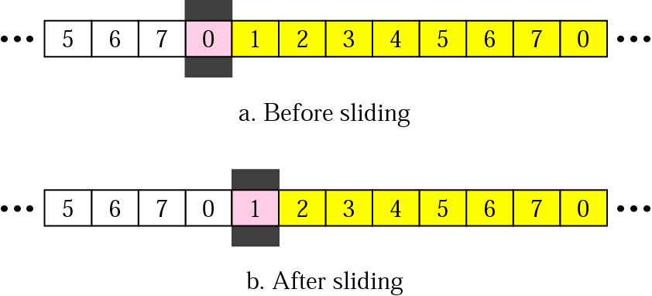
Receiver Sliding Window
Size of the window at the receiving site is always 1 in this protocol.
Receiver is always looking for a specific frame to arrive in a specific order.
Any frame arriving out of order is discarded and needs to be resent.
Receiver window slides as shown in fig. Receiver is waiting for frame 0 in part a.

Slide 27
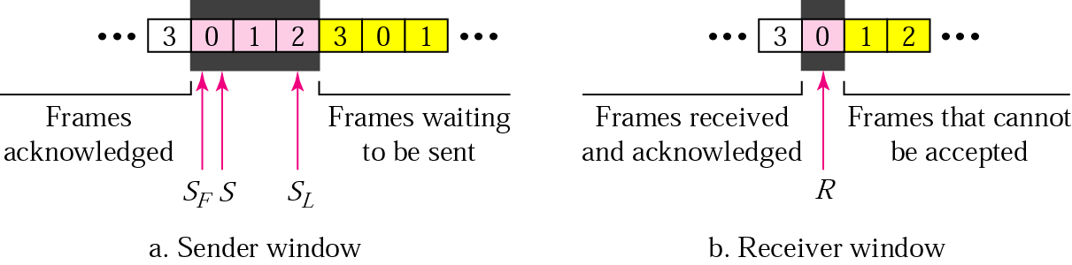
Control Variables
Sender has 3 variables: S, S_{F}, and S_{L}
S holds the sequence number of recently sent frame
S_{F} holds the sequence number of the first frame
S_{L} holds the sequence number of the last frame
Receiver only has the one variable, R, that holds the sequence number of the frame it expects to receive. If the seq. no. is the same as the value of R, the frame is accepted, otherwise rejected.

Slide 28
Acknowledgement
Receiver sends positive ACK if a frame arrived safe and in order.
If the frames are damaged/out of order, receiver is silent and discard all subsequent frames until it receives the one it is expecting.
The silence of the receiver causes the timer of the unacknowledged frame to expire.
Then the sender resends all frames, beginning with the one with the expired timer.
For example, suppose the sender has sent frame 6, but the timer for frame 3 expires (i.e. frame 3 has not been acknowledged), then the sender goes back and sends frames 3, 4, 5, 6 again. Thus it is called Go-Back-N-ARQ
The receiver does not have to acknowledge each frame received, it can send one cumulative ACK for several frames.

Slide 29
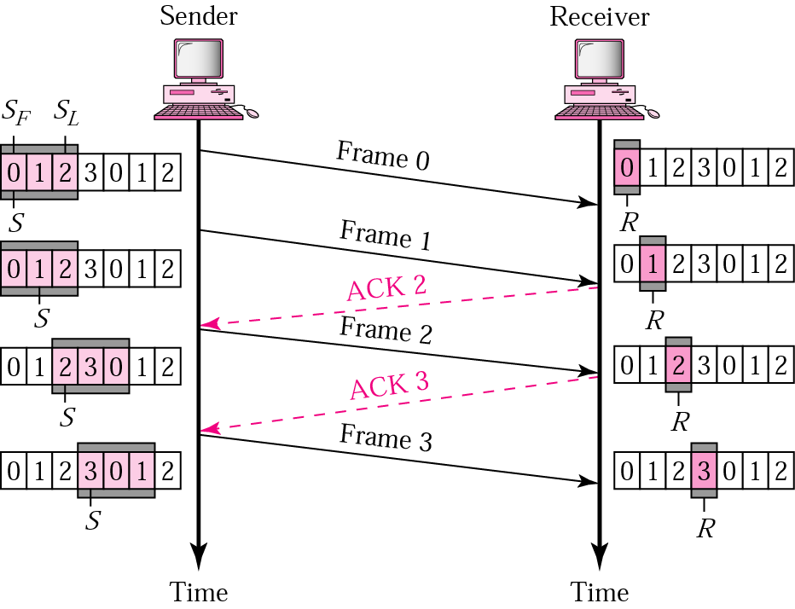
Go-Back-N ARQ, normal operation
The sender keeps track of the outstanding frames and updates the variables and windows as the ACKs arrive.

Slide 30
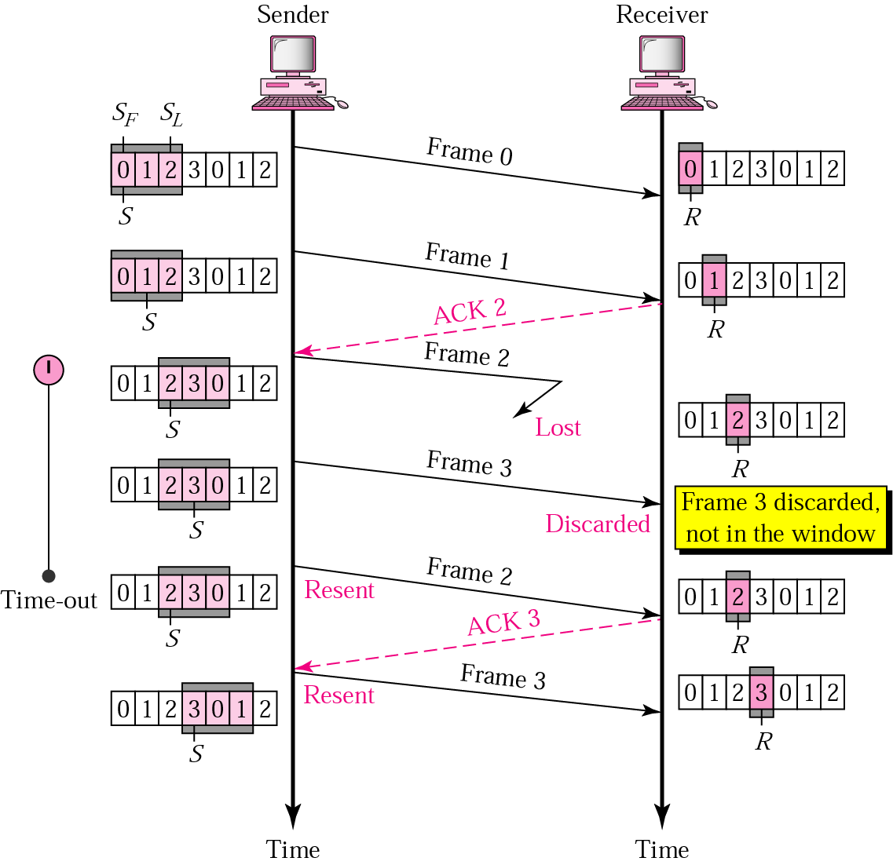
Go-Back-N ARQ, lost frame
Frame 2 is lost
When the receiver receives frame 3, it discards frame 3 as it is expecting frame 2 (according to window).
After the timer for frame 2 expires at the sender site, the sender sends frame 2 and 3. (go back to 2)

Slide 31
Go-Back-N ARQ, damaged/lost/delayed ACK
If an ACK is damaged/lost, we can have two situations:
If the next ACK arrives before the expiration of any timer, there is no need for retransmission of frames because ACKs are cumulative in this protocol.
If ACK1, ACK2, and ACk3 are lost, ACK4 covers them if it arrives before the timer expires.
If ACK4 arrives after time-out, the last frame and all the frames after that are resent.
Receiver never resends an ACK.
A delayed ACK also triggers the resending of frames

Slide 32
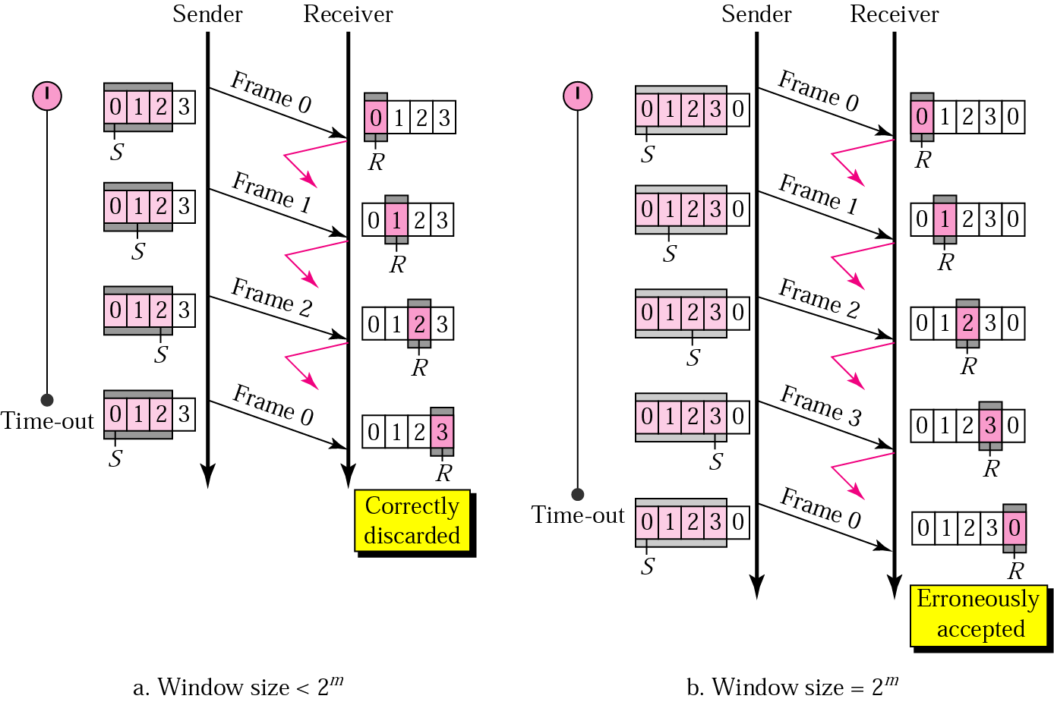
Go-Back-N ARQ, sender window size
Size of the sender window must be less than 2 ^{m}. Size of the receiver is always 1. If m = 2, window size = 2 ^{m} – 1 = 3.
Fig compares a window size of 3 and 4.
Accepts as the 1st frame in the next cycle-an error

Slide 33
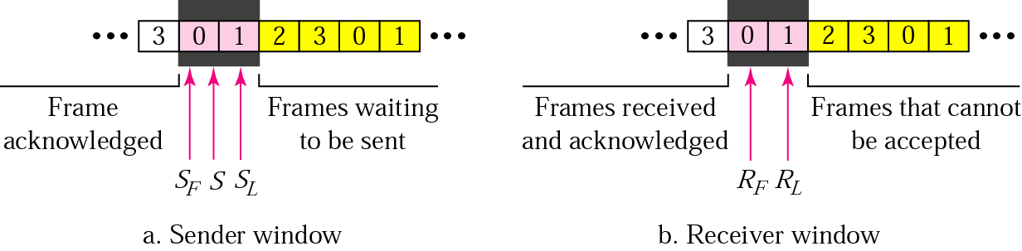
Selective Repeat ARQ, sender and receiver windows
Go-Back-N ARQ simplifies the process at the receiver site. Receiver only keeps track of only one variable, and there is no need to buffer out-of-order frames, they are simply discarded.
However, Go-Back-N ARQ protocol is inefficient for noisy link. It bandwidth inefficient and slows down the transmission.
In Selective Repeat ARQ, only the damaged frame is resent. More bandwidth efficient but more complex processing at receiver.
It defines a negative ACK (NAK) to report the sequence number of a damaged frame before the timer expires.

Slide 34
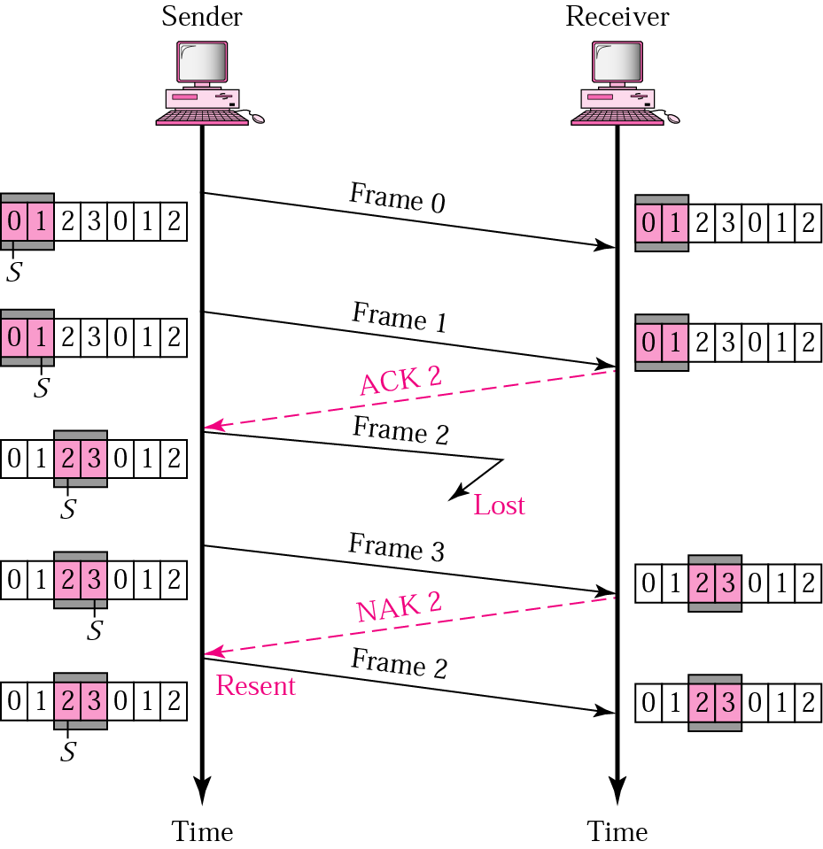
Selective Repeat ARQ, lost frame
Frames 0 and 1 are accepted when received because they are in the range specified by the receiver window. Same for frame 3.
Receiver sends a NAK2 to show that frame 2 has not been received and then sender resends only frame 2 and it is accepted as it is in the range of the window.

Slide 35
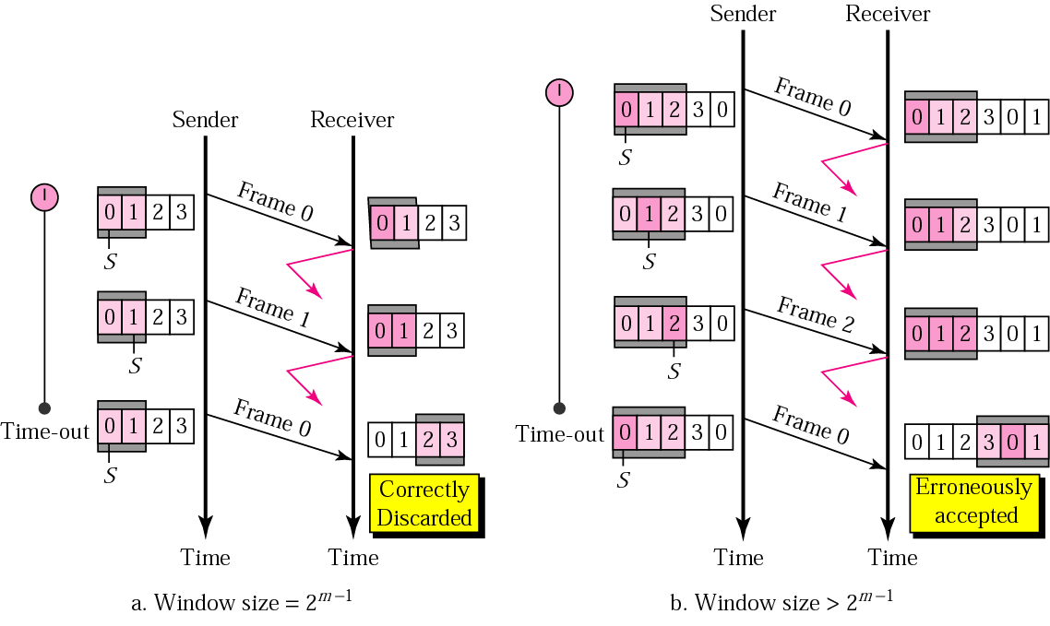
Selective Repeat ARQ, sender window size
Size of the sender and receiver windows must be at most one-half of 2 ^{m}. If m = 2, window size should be 2 ^{m} /2 = 2. Fig compares a window size of 2 with a window size of 3. Window size is 3 and all ACKs are lost, sender sends duplicate of frame 0, window of the receiver expect to receive frame 0 (part of the window), so accepts frame 0, as the 1st frame of the next cycle – an error.

Slide 36
Problems
In SR protocol, suppose frames through 0 to 4 have been transmitted. Now, imagine that 0 times out, 5 (a new frame) is transmitted, 1 times out, 2 times out and 6 (another new frame) is transmitted.
At this point, what will be the outstanding packets in sender’s window?

Slide 37
Consider a network connecting two systems located 8000 km apart. The bandwidth of the network is 500 x 10⁶ bits per second. The propagation speed of the media is 4 x 10⁶ meters per second. It is needed to design a Go back N sliding window protocol for this network. The average packet size is 10⁷ bits. The network is to be used to its full capacity.
Assume that processing delays at nodes are negligible. Then, the minimum size in bits of the sequence number field has to be ______ ?

Slide 38
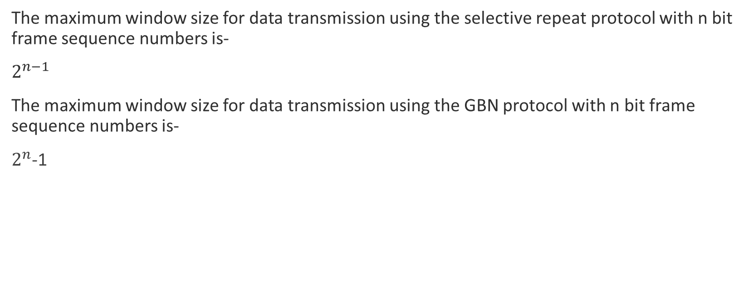
Window Size
The maximum window size for data transmission using the selective repeat protocol with n bit frame sequence numbers is-
$2^{n−1}$
The maximum window size for data transmission using the GBN protocol with n bit frame sequence numbers is-
$2^{n}$-1

